Slide 1
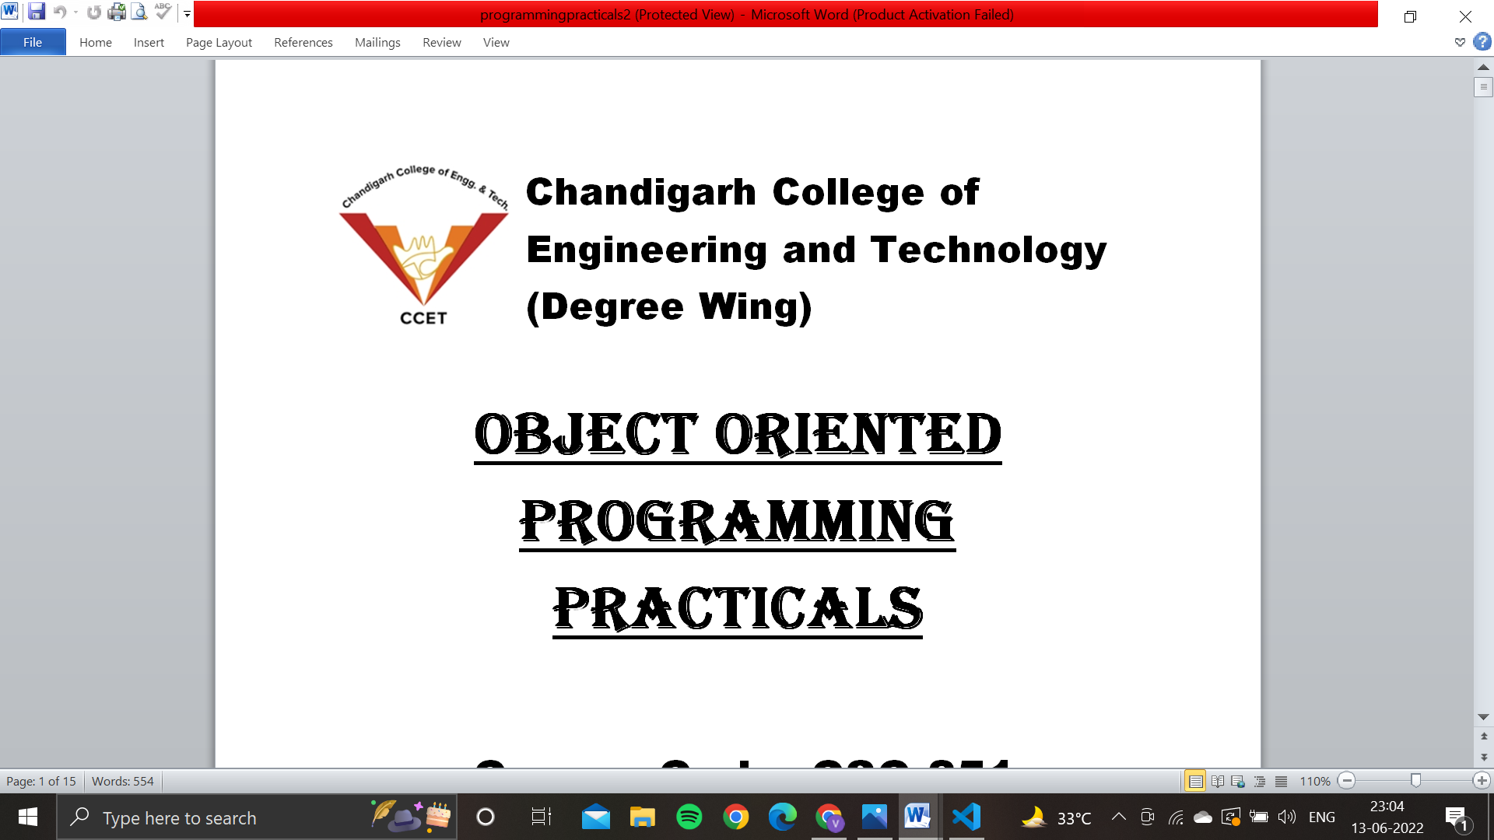
OBJECT ORIENTED PROGRAMMING PROJECT
NAME: VANSHIKA BHARDWAJ
ROLL NO: CO21366
COURSE CODE: CSC 251
BRANCH: CSE
SEMESTER/YEAR: 2ND (FIRST YEAR)
SUBMITTED TO: DR. SARABJEET SINGH

Slide 2
Project Name: Appointment Booking
Objective of the project: Successfully build a program for booking doctor appointments.
Keys features of the project:
Manage Doctor Appointment Slots: It is used to create available slots which will be displayed when a patient/user wants to see or book the slots.
Book Appointment : A user/patient can book appointment slot.
See All Existing Slots : Using this we can check how many slot is available or booked.

Slide 3
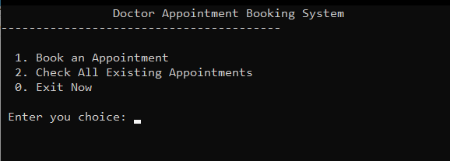
Main Screen: The first screen when you run the project.

Slide 4
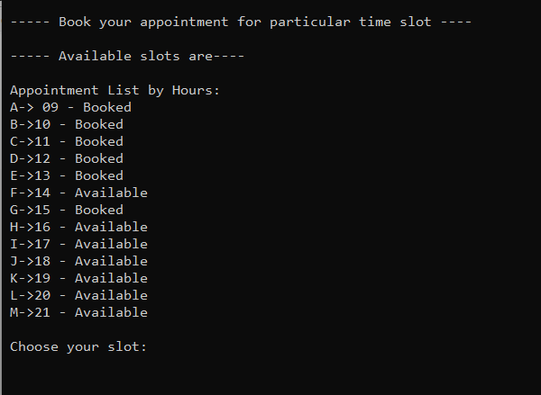
Book your appointment Screen: Slots will be displayed to you basis of hours with reference Example: A, B, C and so on.. with a status Available or Booked.

Slide 5
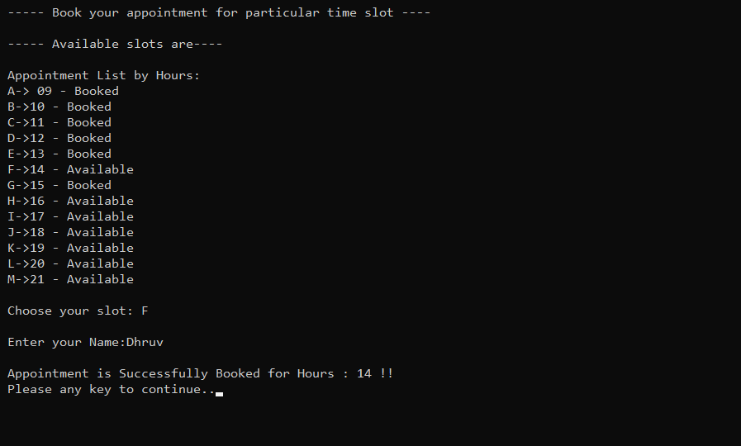
Appointment Booked Screen: In this screen you will get a message of successfully booked.

Slide 6
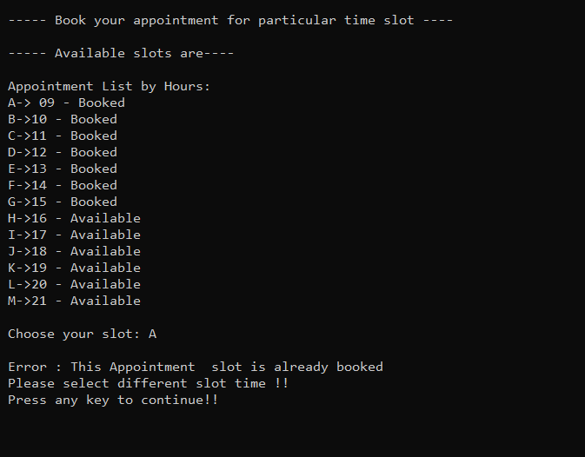
Already Booked Slot: In case you select the booked appointment it will display you a following screen.

Slide 7
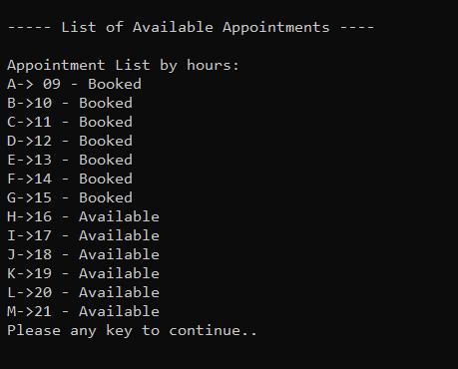
Existing Appointment Screen: This screen will display list of available appointments.

Slide 8

Exit Screen: This screen displays the end of the program and asks for confirmation from the user.

Slide 9
THANK YOU

